Slide 1
Problem Statement
PS 10 : Creating 2D Occupancy Grid Map using overhead
infrastructure cameras

Slide 2
Unique Idea Brief (Solution)
This project proposes using overhead cameras to perform SLAM, a task traditionally handled by mobile robots equipped with sensors. By using stationary cameras, we can create a real-time occupancy grid map of the room, providing a cost-effective and robust solution for indoor mapping and monitoring. The system integrates image processing, object detection, and semantic labeling to enhance the functionality of the map.

Slide 3
Features Offered
Real-time Mapping: Generates and updates the occupancy grid map in real-time.
Accurate Image Stitching: Combines images from multiple cameras to create a unified view.
Obstacle Detection and Tracking: Detects static and dynamic obstacles and updates the grid accordingly.
Semantic Labeling: Labels detected objects with semantic information for better context understanding.
Comparison with AMR Maps: Validates and compares the generated map with maps created by AMRs to ensure accuracy.

Slide 4
Process flow
1. Capture Images from Cameras (Image Stitching Node):
Install multiple overhead cameras to cover the room.
Capture live video feeds from these cameras.
Use OpenCV to stitch these images together to form a single panoramic view of the room.
2. Convert Image to Grayscale and Threshold:
Convert the stitched image to grayscale.
Apply thresholding to convert the grayscale image into a binary image, creating an initial binary occupancy grid.
3. Generate Occupancy Grid:
Process the binary image to identify free and occupied spaces.
Create the initial occupancy grid map based on the processed image.

Slide 5
Process flow (Contd.)
4. Detect and Update Moving Objects:
Implement object detection using a pre-trained model like YOLO or SSD.
Detect dynamic objects and update their positions on the occupancy grid.
5. Add Semantic Information:
Label detected objects with semantic information (e.g., "chair," "table").
Update the occupancy grid to include these semantic labels for better contextual understanding.
6. Validate and Compare with AMR-generated Map:
Compare the generated occupancy grid map with maps created by AMRs to validate accuracy.
Adjust and refine the system based on the comparison results to enhance performance.

Slide 6
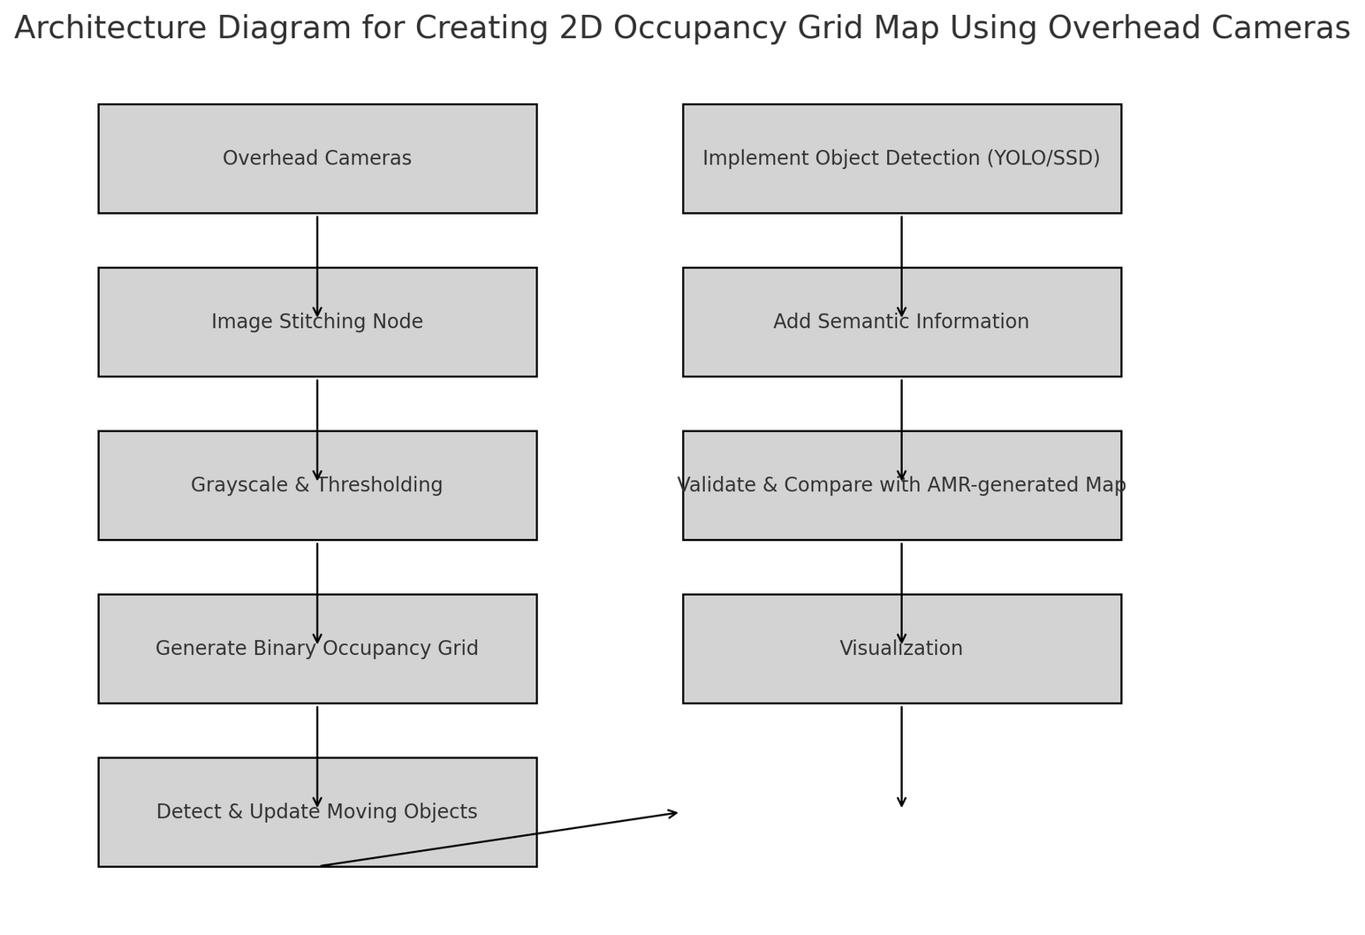
Architecture Diagram

Slide 7
Technologies used
OpenCV: For image stitching, processing, and computer vision tasks.
Python: The main programming language for implementing the solution.
ROS2 (Robot Operating System 2): For data processing, SLAM algorithms, and system integration.
NumPy: For efficient array operations and numerical computations.
Matplotlib: For visualizing the occupancy grid map.
YOLO/SSD: Pre-trained models for object detection.
Camera Hardware: High-resolution overhead cameras.

Slide 8
Team members and contribution:
Name : Anand Ji Parasar
Individual project
Mentor : Dr. Shilpa Suresh

Slide 9
Conclusion
This project demonstrates a novel approach to indoor mapping by utilizing overhead cameras for SLAM, traditionally performed by mobile robots. By integrating image processing techniques, pre-trained object detection models, and ROS2-based SLAM algorithms, we can generate a reliable and accurate 2D occupancy grid map. The addition of semantic information further enhances the map's usability, providing valuable context for various applications.
Validating and comparing the generated map with AMR-created maps ensures its accuracy and reliability. This solution offers a scalable, cost-effective, and stationary alternative to traditional mobile robot-based SLAM systems, opening new possibilities in the field of indoor mapping and monitoring.

